Slide 1
Project Title:
Diabetes Prediction
Team Member and Roll No.
Ashutosh Panda (2210990191)-Leader Ashutosh Singh(2210990192)
Bhagya Sharma(2210990210)
Bharat Jakhar(2210990192)

Slide 2
Index
Objective
Introduction
Approach & Technique
Algorithm
Result
Source Code (screenshots)
Conclusion
Reference

Slide 3
Objective
The primary objective of this project is to develop machine learning models capable of predicting the likelihood of diabetes in women based on relevant patient features. By accurately classifying patients into categories such as “The Person is not diabetic” OR “The Person is diabetic” for diabetes, healthcare providers can implement timely interventions to prevent adverse health outcomes. Specifically, the project aims to:

Slide 4
Introduction
﻿
Diabetes is a disease which is rapidly increasing all over the world. It occurs when pancreas does not produce sufficient insulin, or body can not
sufficiently use insulin it produces. Diabetes person has increase blood glucose in the body. One of the major problem diabetic patients suffers from is the Diabetic Retinopathy (DR) and blindness. Since the number of diabetes patients is continuously increasing, it increases the data as well.

Slide 5
Approach & Techniques
1. Data Visualization Tools: Matplotlib will be employed for data visualization to gain insights into the dataset distribution and model performance, aiding in model interpretation and validation
2. Linear Regression : Linear regression will be implemented to predict the likelihood of diabetes based on the input features.
3. Logistic Regression: Logistic Regression will be implemented to predict the probability of diabetes based on the input features.
4 . Mean squared error(MSE) : Mean squared error (MSE) is a metric used to evaluate the performance of the linear regression model in predicting the likelihood of diabetes based on the input features.

Slide 6
Algorithm
Data Preprocessing : - Handling Missing Values: Missing values will be imputed using appropriate techniques such as mean, median, or mode imputation.
Feature Selection: - Correlation Analysis: Pearson correlation coefficient will be computed to identify highly correlated features and remove redundant ones.
Model Development:
1. Linear Regression
2.Logistic Regression
3.Mean Squared Error
Model Evaluation : The models will be evaluated using metrics such as accuracy, precision, recall, F1-score, and confusion matrix to assess their performance in predicting diabetes status.
Implementation: The proposed design and methodology will be implemented using Python programming language and relevant libraries such as scikit-learn, pandas, and matplotlib

Slide 7
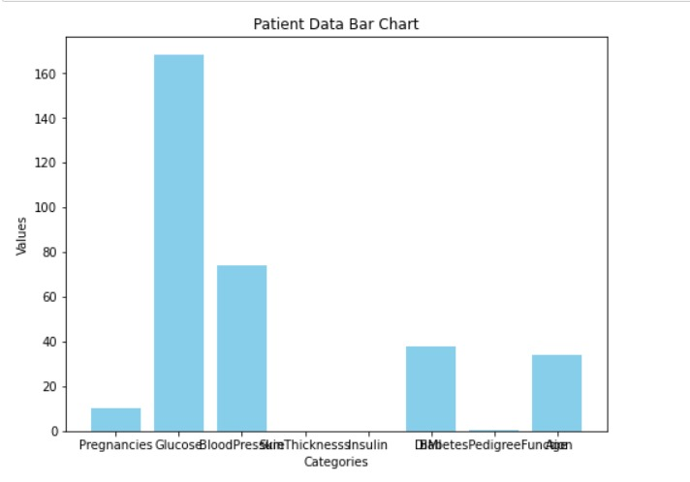
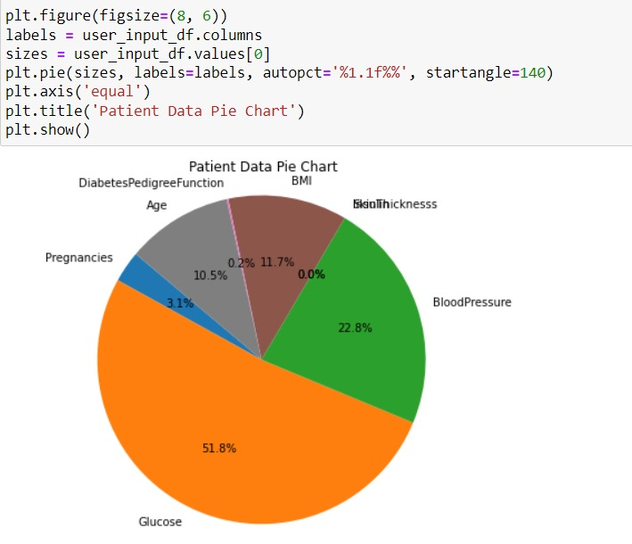
Screenshot

Slide 8
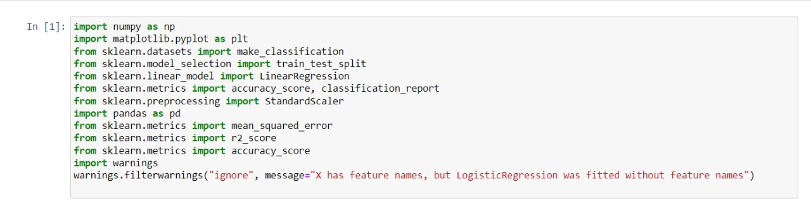
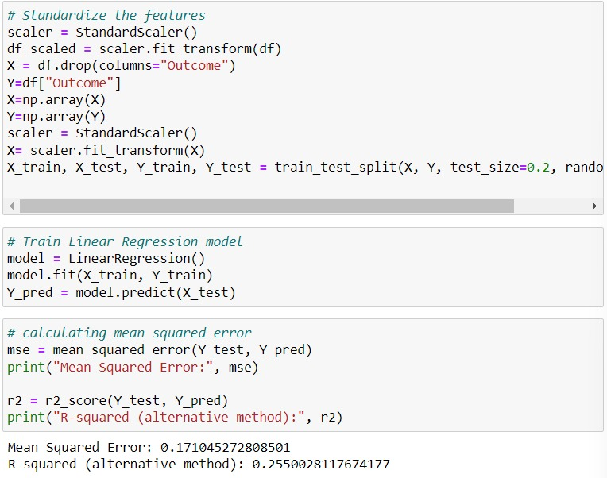
Screenshot

Slide 9
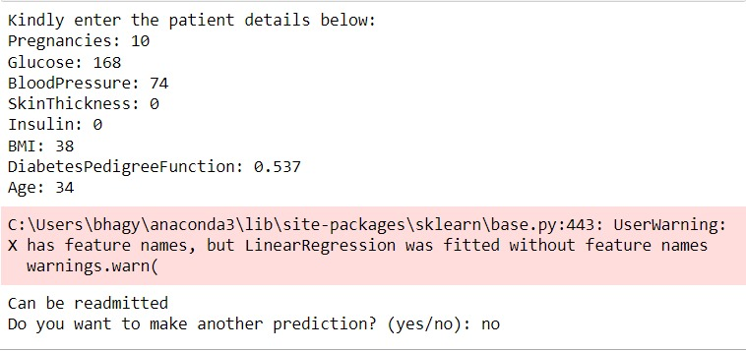
Result

Slide 10
conclusion
In this presentation machine learning methods are used for the prediction of Diabetic Retinopathy in patients, using their health records of diabetes
These health records were organized in a structured way by eliminating noisy data. With the help of machine learning algorithms, knowledge is extracted from these records in the form of numerical values for the prediction of DR.

Slide 11
Reference
https://www.dropbox.com/s/uh7o7uyeghqkhoy/diabetes.csv?e=4&dl=0 -> (FOR THE DATASET)
https://www.youtube.com/
https://www.geeksforgeeks.org/python-for-machine-learning/?ref=shm

Slide 12
Thank you!

